Slide 1

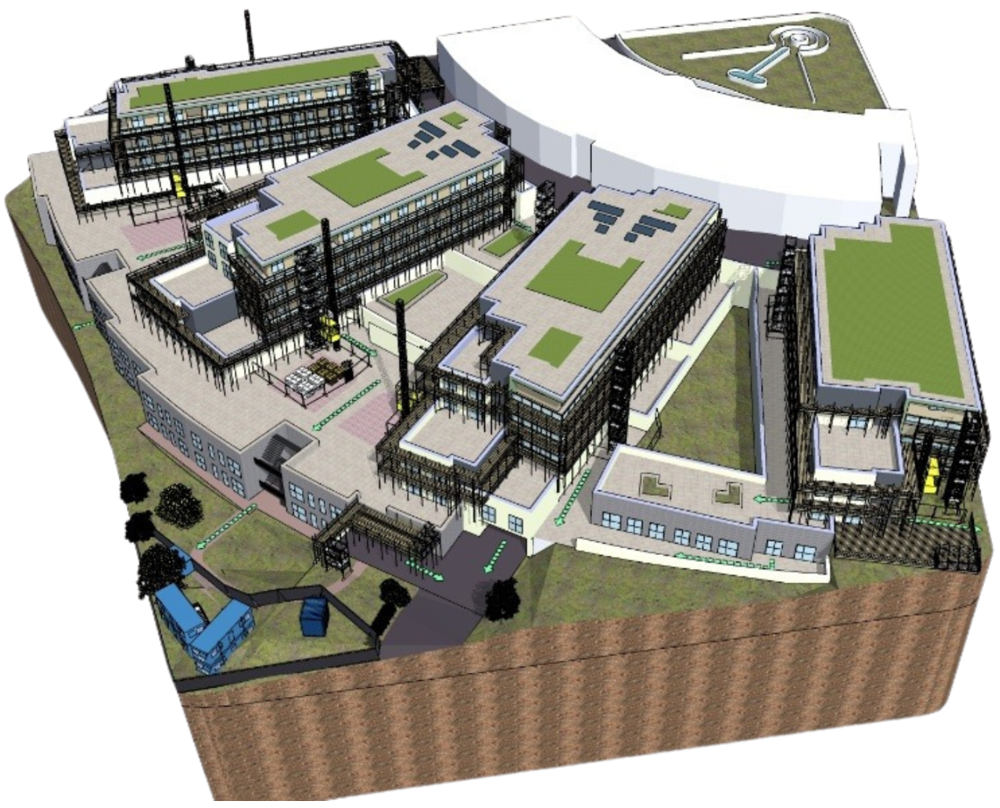
Grand Ocean
Resident & Leaseholder Newsletter
July 2026

Slide 2
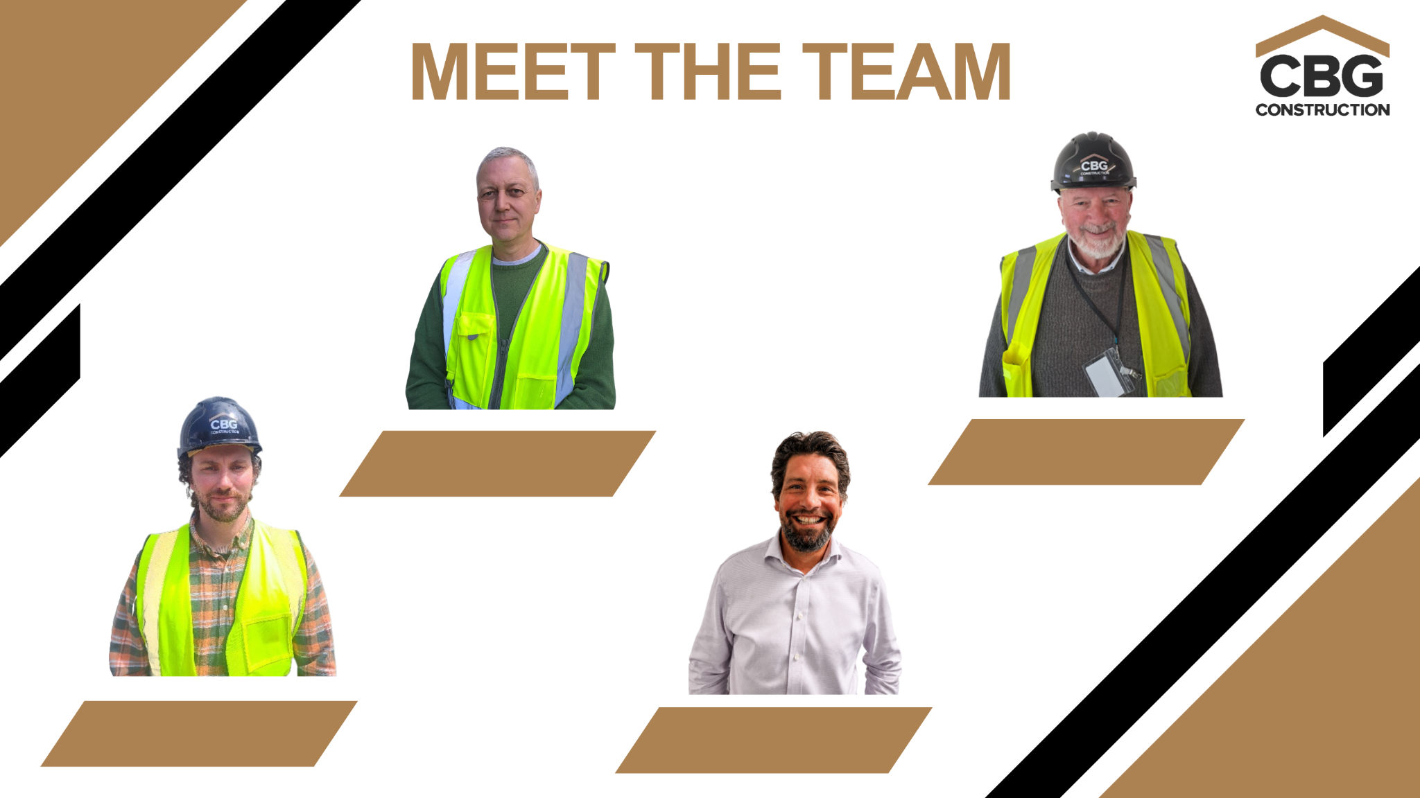
Richard Etherington
Gary Plastow
Project Manager
Site Manager
David Murdoch
Andy Plail
Site Manager & Resident Liaison Officer
Southern Operations Manager

Slide 3

PROJECT UPDATE
Monthly Newsletter: July 2026
I am pleased to report that we now fully set up on site and we are in the process of moving from a temporary electrical supply to a permanent supply which will mean we no longer need to use the generators.
Works to Atlantic Heights have progressed as per our construction programme and the demolition phase of works are now complete.
We have now completed the scaffolding to Ionian Heights and we have now started to strip the existing render and rainscreen panels. This should be complete during July and will allow the existing sheathing boards to be replaced with a new non-combustible material.
The scaffolding installation to Caspian Heights has just commenced with Pacific Heights following in Pacific heights in late July.

Slide 4

Project Update (Continued)
Updates
Pedestrian Access & Safety: The Ionian pedestrian pathway to the front door is too close to the hoist and material storage/movement areas. Allowing pedestrian access to and from Suez Way via this route poses a serious health and safety risk and will be closed.
Alternative Routes: We apologise for the inconvenience, but residents must use the fob access door on Suez Way. Visitors and deliveries will need to use the steps from Withyham Avenue. We have obtained a specific Fire Risk Assessment report, which confirms these alternative arrangements fully meet safety exit requirements.
Garden Areas: All garden areas will be fenced off for the duration of the works to ensure the health and safety of all site users. Some of these areas will be used for plant equipment and material storage.
Patios, Terraces, and Balconies: These will be active working site areas. For your own health and safety, as well as that of the site workers, residents must not attempt to use any of these areas at any time.
CCTV: The CCTV installation to Atlantic and Ionian is now complete. The external monitoring is now live on Atlantic and Ionian from the 15th July 2026. We will provide further updates on Pacific and Caspian in due course.
Pets: For their own safety, pets are strictly prohibited from accessing the scaffolding or any active work areas.

Slide 5
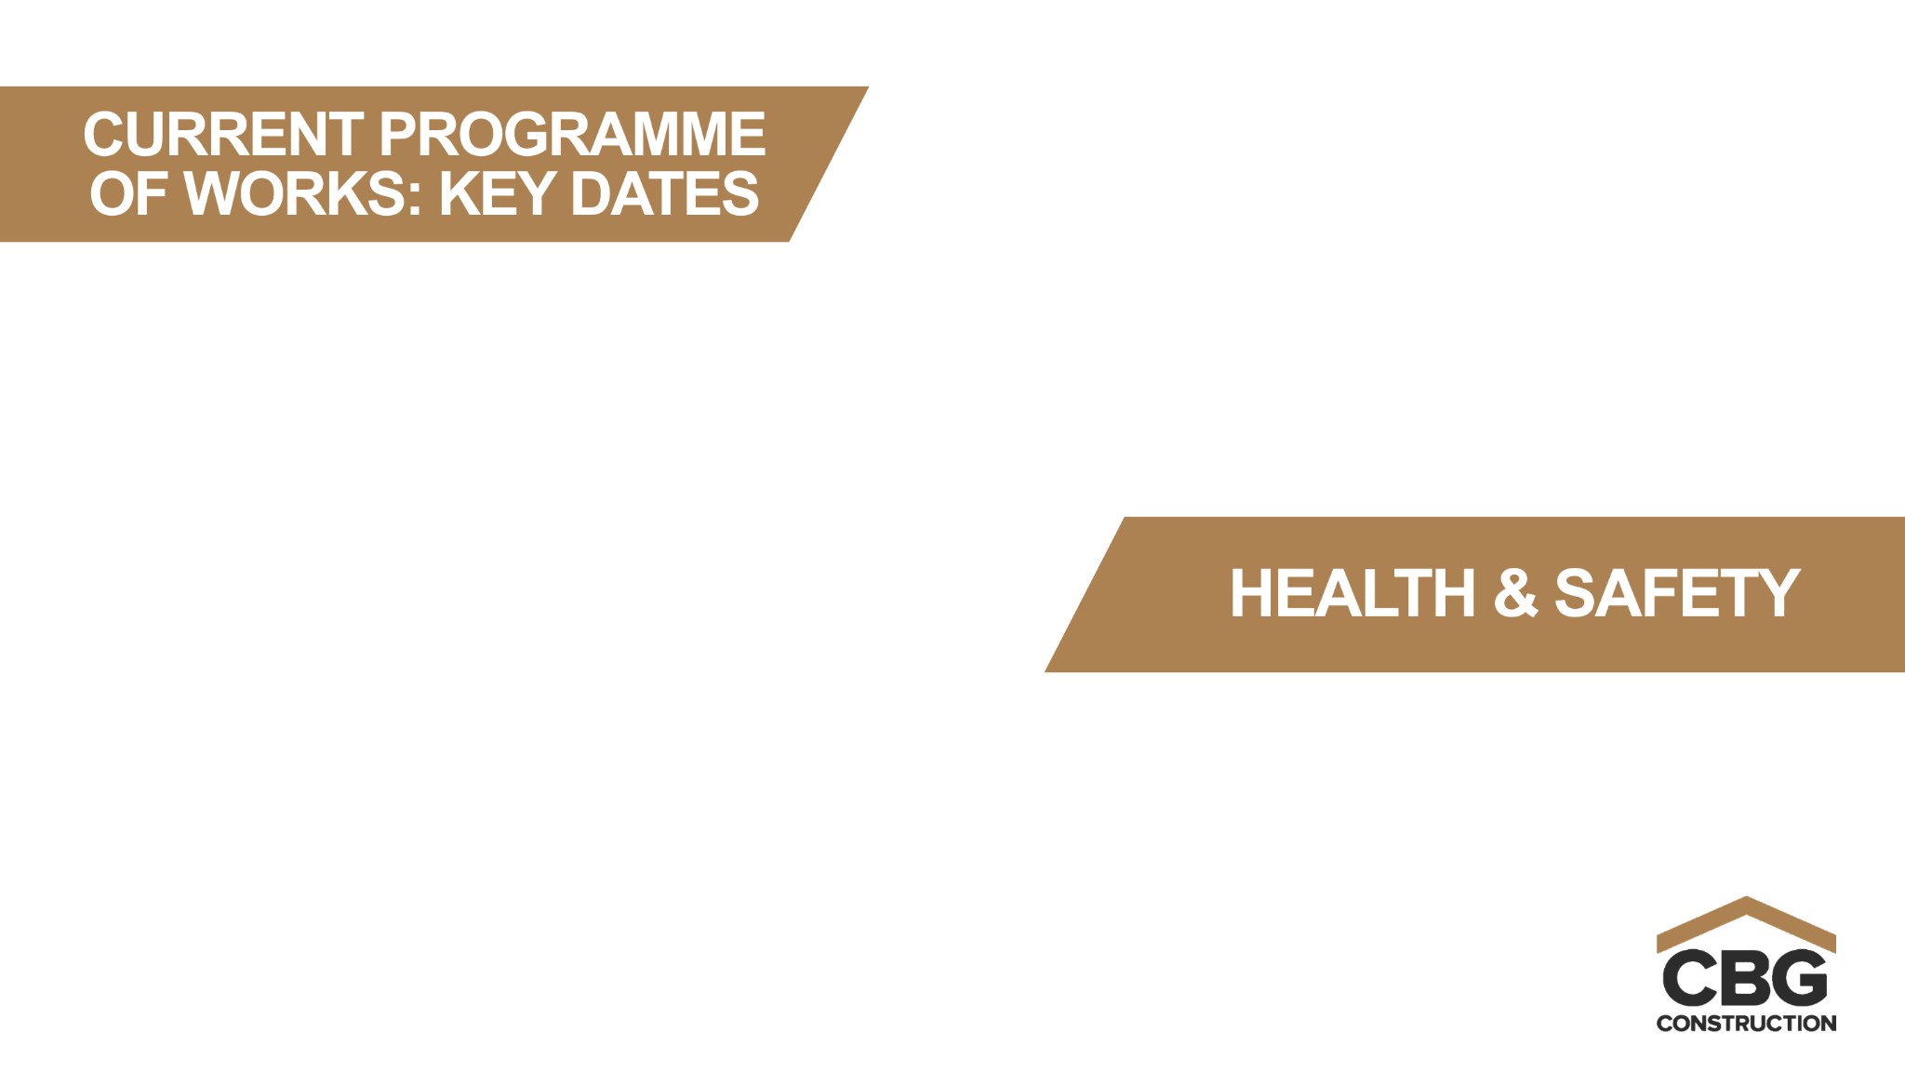
We remain on programme to complete the façade remediation works in Autumn 2027 with the wider reinstatement works/ landscaping to the estate commencing as we strike the scaffolding to each building.
Health and safety is always our number one priority. I am pleased to report that we have had no accidents since the start of the project.

Slide 6
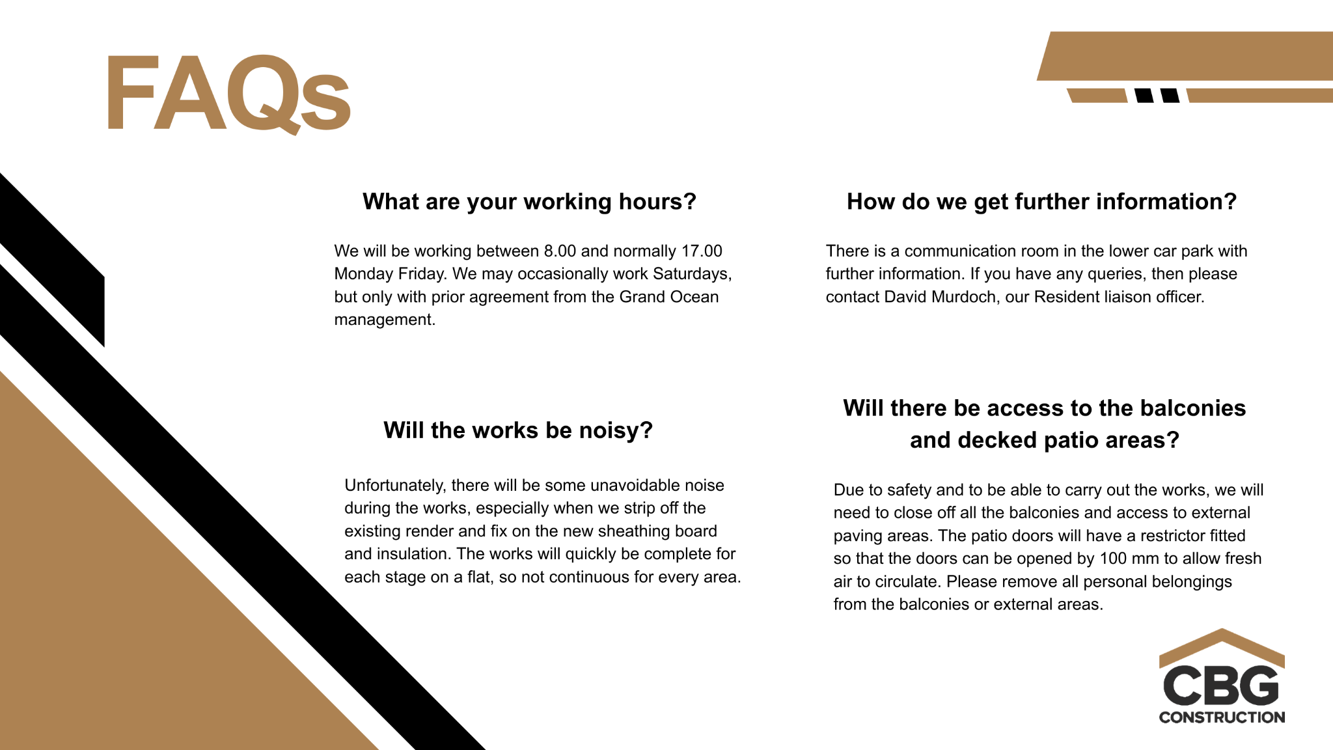

Slide 7
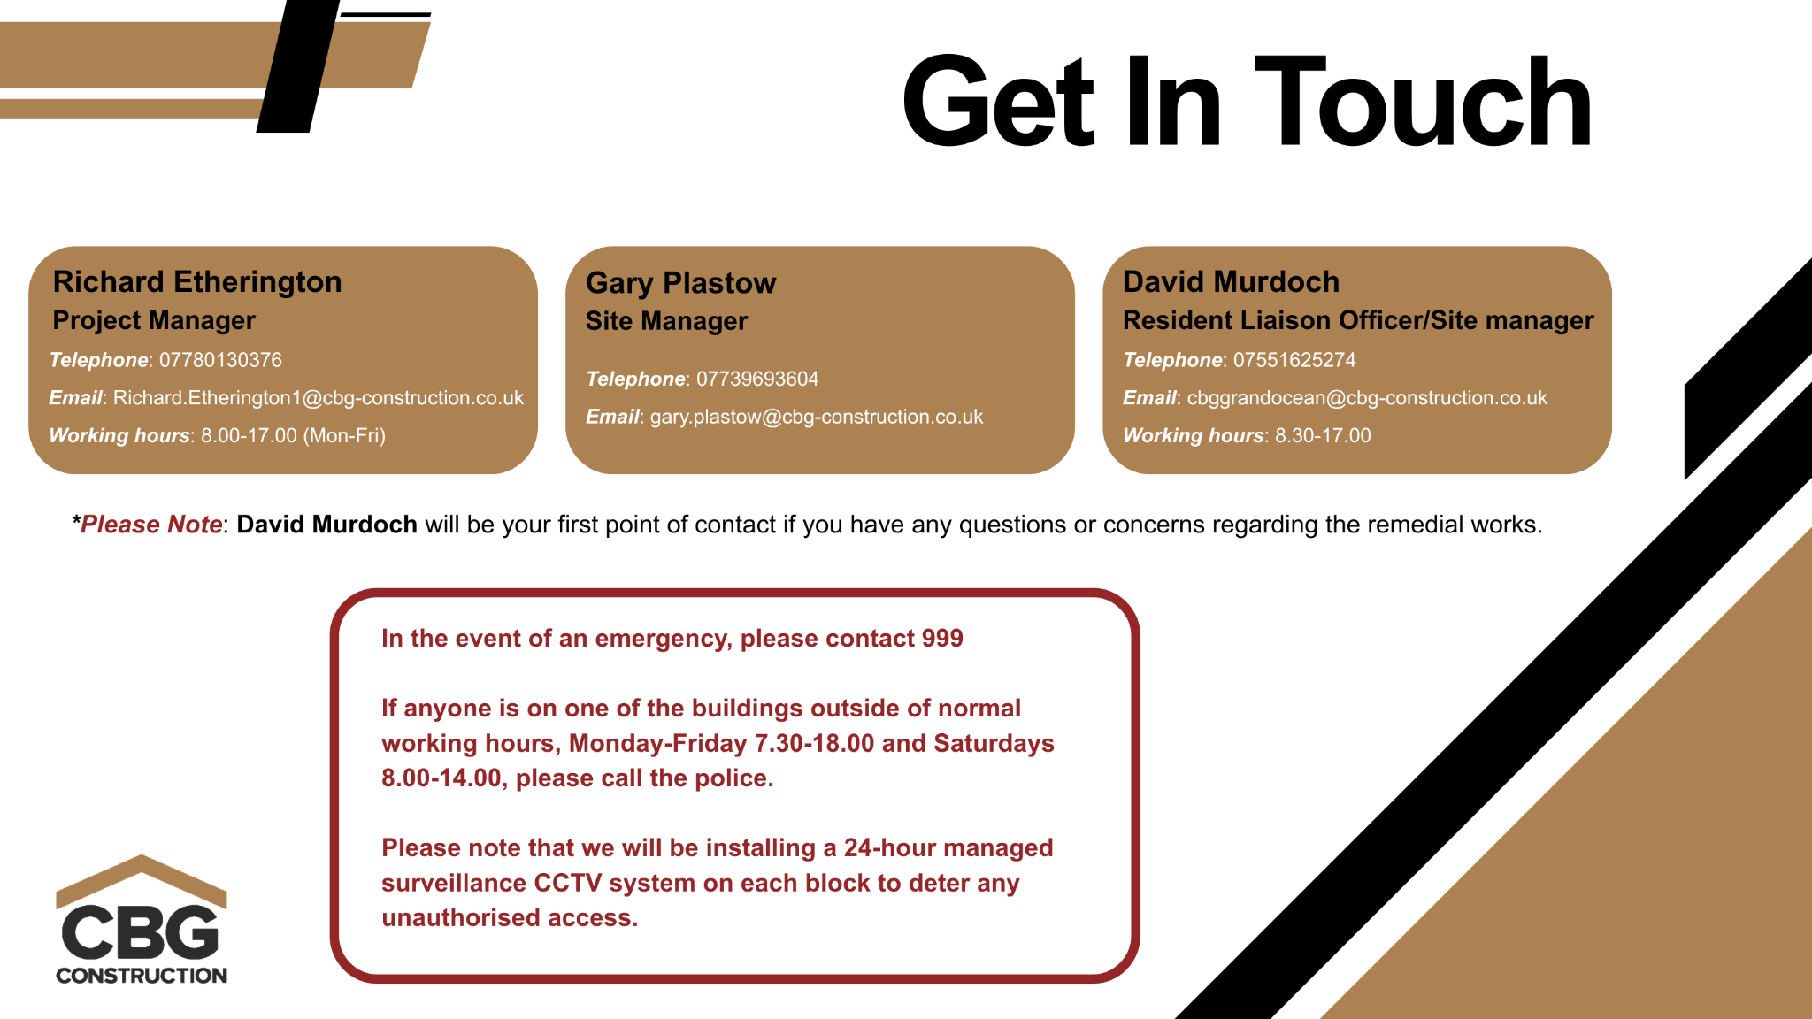

Slide 8

Stay Tuned, More Updates Coming Soon!

